Slide 1
DEPARTMENT OF FLORIDA
EDUCATION
PLAN OF ACTION
2014-2015
Pat Devine – Chairman
Committee Members
Robin Briere – Ruth Sovern

Slide 2

“LIGHTING THE WAY FOR VETERANS”
“Veterans in the Classroom: History in the First Person”

Slide 3
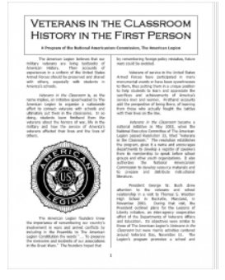

Slide 4
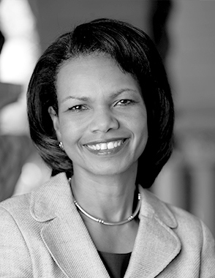
CONDOLEEZZA RICE
Former U.S. Secretary of State

Slide 5
SCHOLARSHIPS & AWARDS
Department Scholarships
Memorial Scholarships
Master’s Scholarships
National Scholarships
Department Awards
National Unit Awards
Give 10 to Education

Slide 6
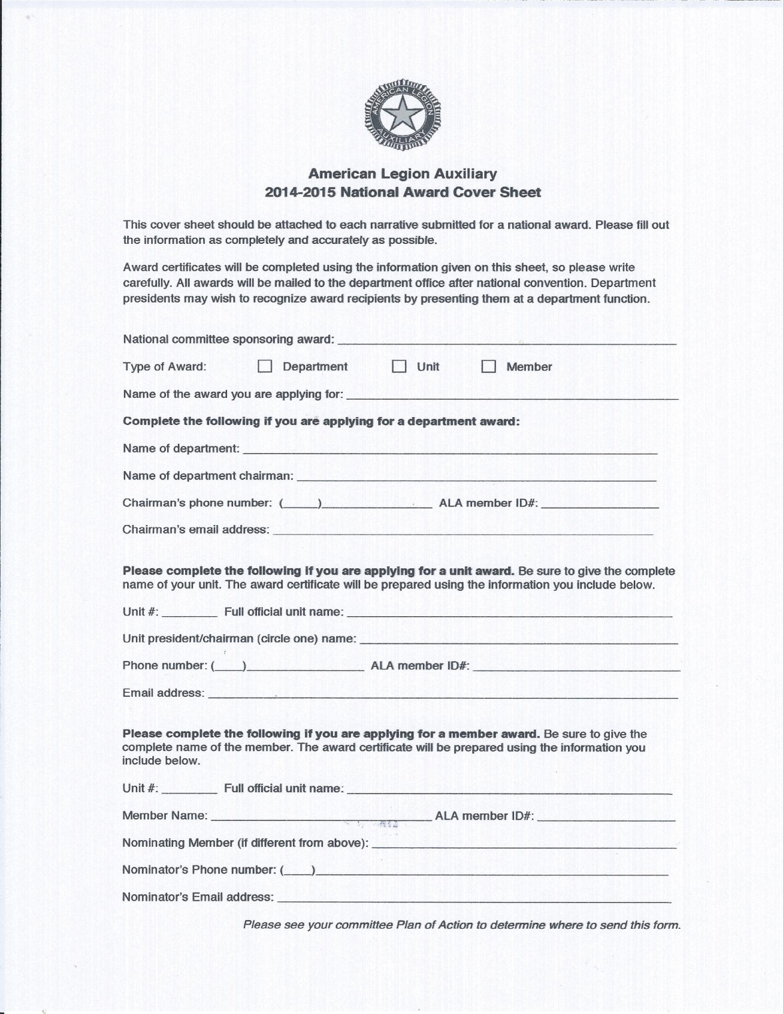

Slide 8



Slide 9
Additional Resources You Can Use
1. Veterans in the Classroom: www.alaforveterans.org/Programs/Education
2. American Legion Auxiliary scholarship applications:
www.alaforveterans.org/Scholarships
3. Educational resources through the Americanism and Children & Youth Commission
of The American Legion: www.legion.org/education
4. Free online tutoring for military children: www.tutor.com/military
5. Student Veterans of America: www.studentveterans.org
6. American Legion Flag and Emblem Sales for educational products at www.emblem.legion.org.

Slide 10
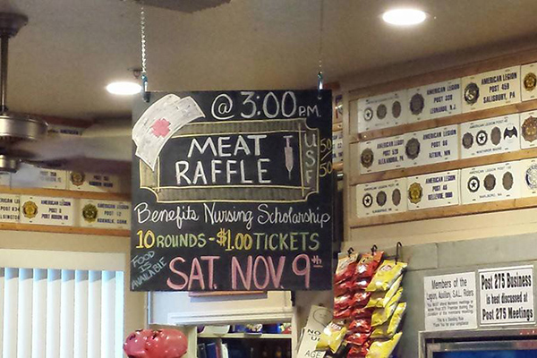
USF College of Nursing receives generous donation from American Legion Auxiliary Post #275 - February 21, 2014 · 2:39 pm
University of South Florida College of Nursing received a generous donation from American Legion Auxiliary Post #275 during a fundraiser event held on Nov. 9, 2013 in Dunedin, Fla
USF Foundation 270035 – American Legion Post 275 FAMILY – Veterans Scholarship

Slide 11
REPORT DUE DATES
Mid-Year
Unit to District – November 15, 2014
District to Department – December 1, 2014
Year End
Unit to District – April 15, 2015
District to Department – May 1, 2015

